Slide 1
CS105.3 Database Management Systems
by: Manoja Weerasekara

Slide 2
Delivery Schedule
Course Duration
15 weeks
12 Lectures + 2 Revision + 1 Mid Exam
Practical
Mandatory 1 × 2 hour practical per week
Tutorials
1 × 1 hour tutorial per week (we’ll notify you)
Answers will be discussed ONLY during the Tutorial class.

Slide 3
Evaluation Criteria
Formal Exam 60% (3 hour paper)
In course Assignments 40% (Quizzes, Assignments, Tutorials)

Slide 4
Recommended Texts
Fundamentals of Database Systems’ by Elmasri/Navathe
‘Database Systems: A practical approach to design, implementation and management’ by Connolly and Begg

Slide 5
Road Map
DB Concepts
Introduction to DBMS
Database Architecture
Data Models
Database Design Methodology

Slide 6
Road Map
Entity Relationship Diagrams
Entities
Relations
Attributes
Mapping Conceptual model into Relational Schema
Data Normalization
INF
2NF
3NF
SQL

Slide 7
Database Management Systems

Slide 8
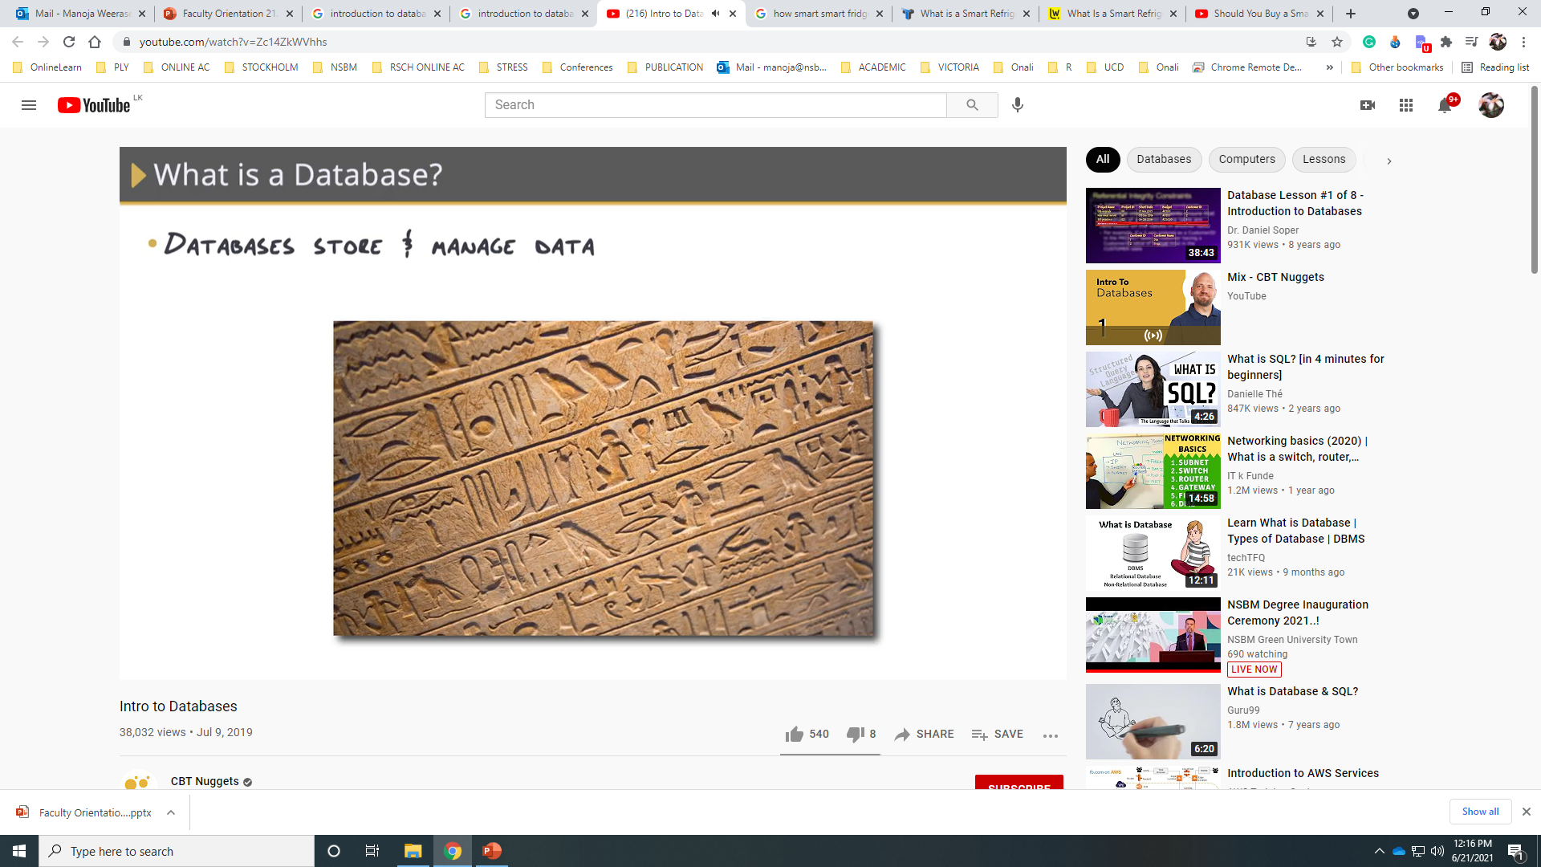
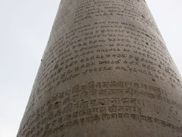
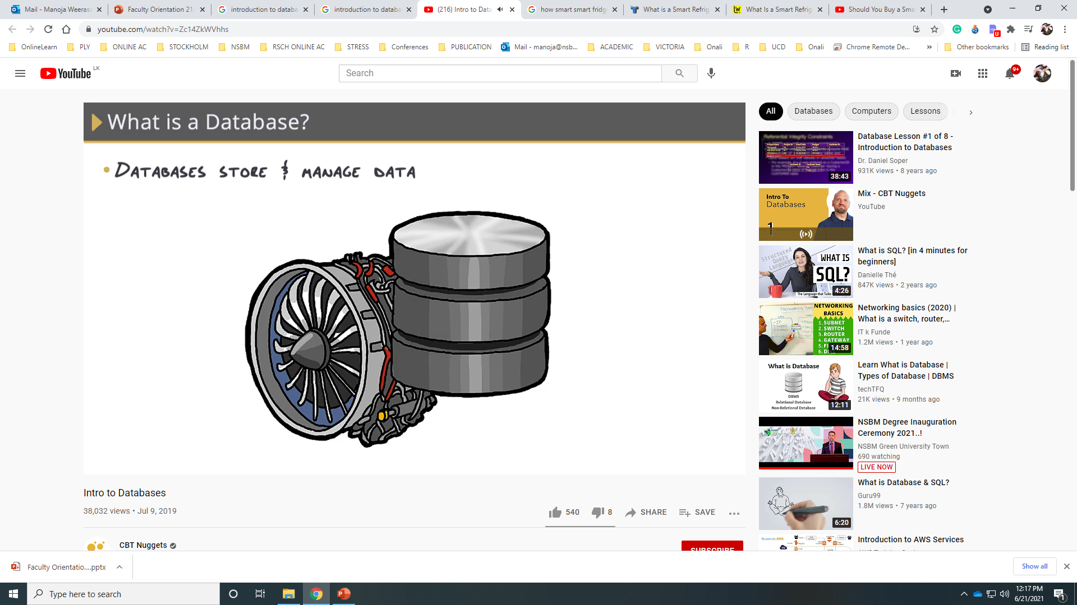
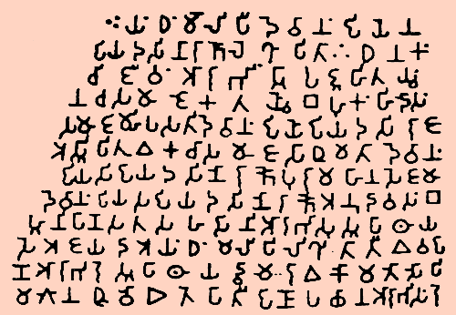
Store and Manage Data

Slide 9
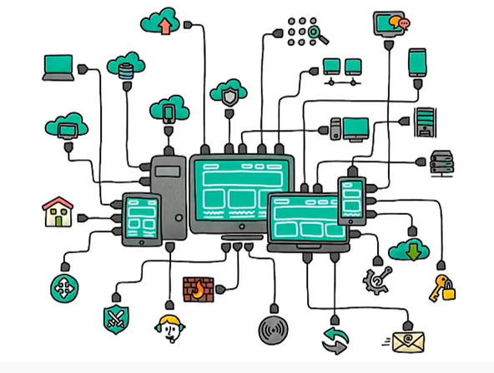
Data is generated manually and automatically

Slide 10
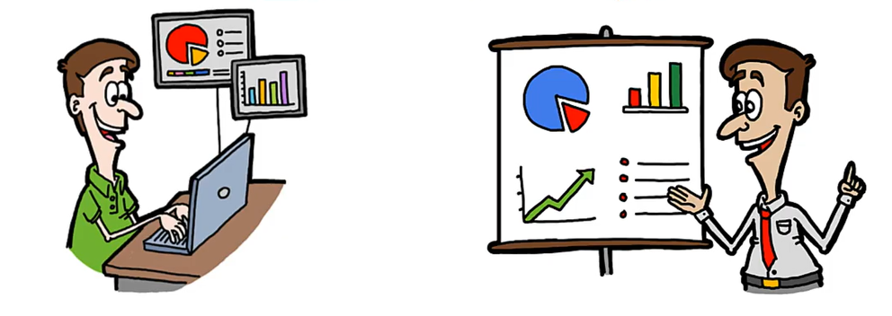
Data is used (consumed) by end-users and different applications

Slide 11
Audio
Text
Files
Numbers
Video
Amounts
Images
Dates

Slide 12
If You Have Data, Do You Need a Database store them???

Slide 13

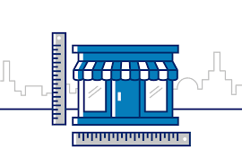
Using Text File or Spreadsheets

Slide 14
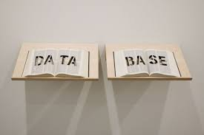

Slide 15
Size of Data
Scalability??
Ease of Updating
Multiple Access??
Accuracy
Validation??

Slide 16
Security
Access/Privacy??
Redundancy
Multiple Copies??
Incomplete
Integrity??

Slide 17
Database Concepts
The need of database systems arose in the early 1960s in response to the traditional file processing system.
In the file processing system, the data is stored in the form of files, and a number of application programs are written by programmers to add, modify, delete, and retrieve data to and from appropriate files.
New application programs are written when needed by the organization.

Slide 18
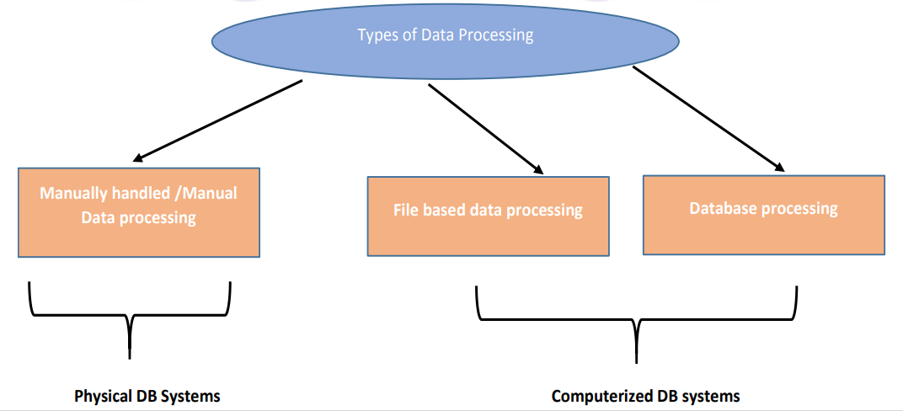

Slide 19
File Processing Systems
Billing
Program
Purchasing
Program
Customer
file
Accounts
receivable
file
Buyer
file
Inventory
file
Vendor
file
Accounts_Payable
Program
Sales Order Processing
Program
Payroll
Program
Vendor
file
Invoice
file
Customer
file
Inventory
file
Employee
file
Notes:
1

Slide 20
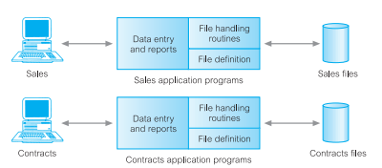

Slide 21
What are the problems that you may find in the previous approach?

Slide 22
Examples of Database Applications
Purchases from the supermarket
Purchases using your credit card
Booking a holiday at the travel agents
Using the local library
Taking out insurance
Using the Internet
Studying at university

Slide 23
What is data, database, DBMS
Data: Known facts that can be recorded and have an implicit meaning; raw
Database: a highly organized, interrelated, and structured set of data about a particular enterprise Controlled by a database management system (DBMS)
DBMS
Set of programs to access the data
An environment that is both convenient and efficient to use
Database systems are used to manage collections of data that are:
Highly valuable
Relatively large
Accessed by multiple users and applications, often at the same time.
A modern database system is a complex software system whose task is to manage a large, complex collection of data.
Databases touch all aspects of our lives

Slide 24
Types of Databases and Database Applications
Traditional applications:
Numeric and textual databases
More recent applications:
Multimedia databases
Geographic Information Systems (GIS)
Biological and genome databases
Data warehouses
Mobile databases
Real-time and active databases

Slide 25
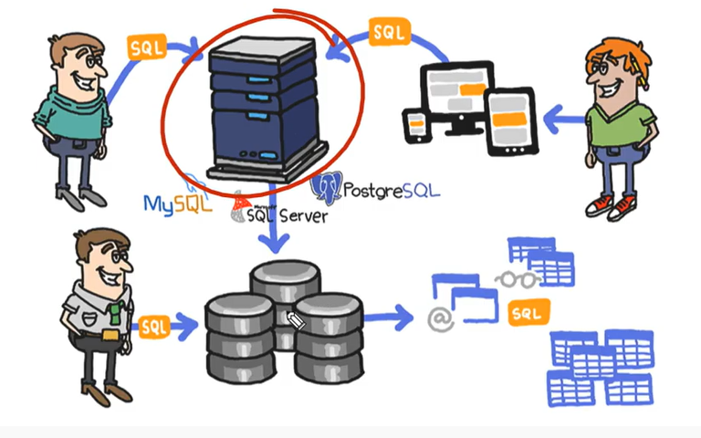
DBMS is a software or it’s an engine that enables users/applications to access, manipulate, and report on data stored in databases.

Slide 26
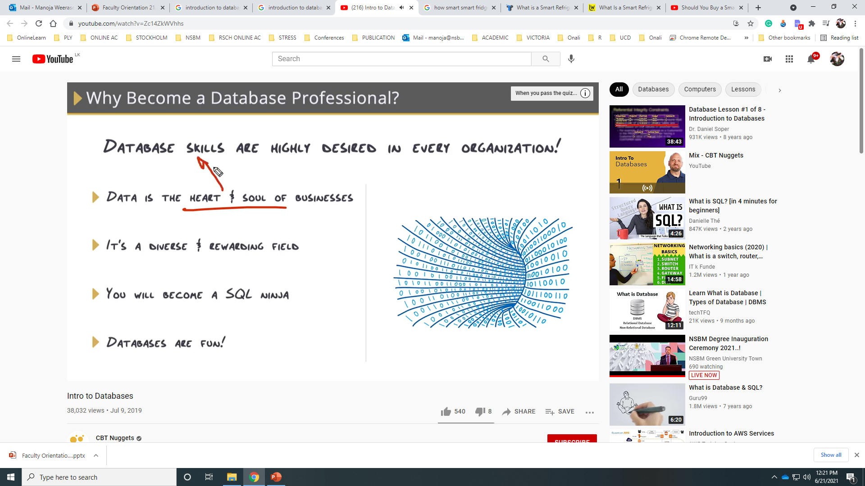
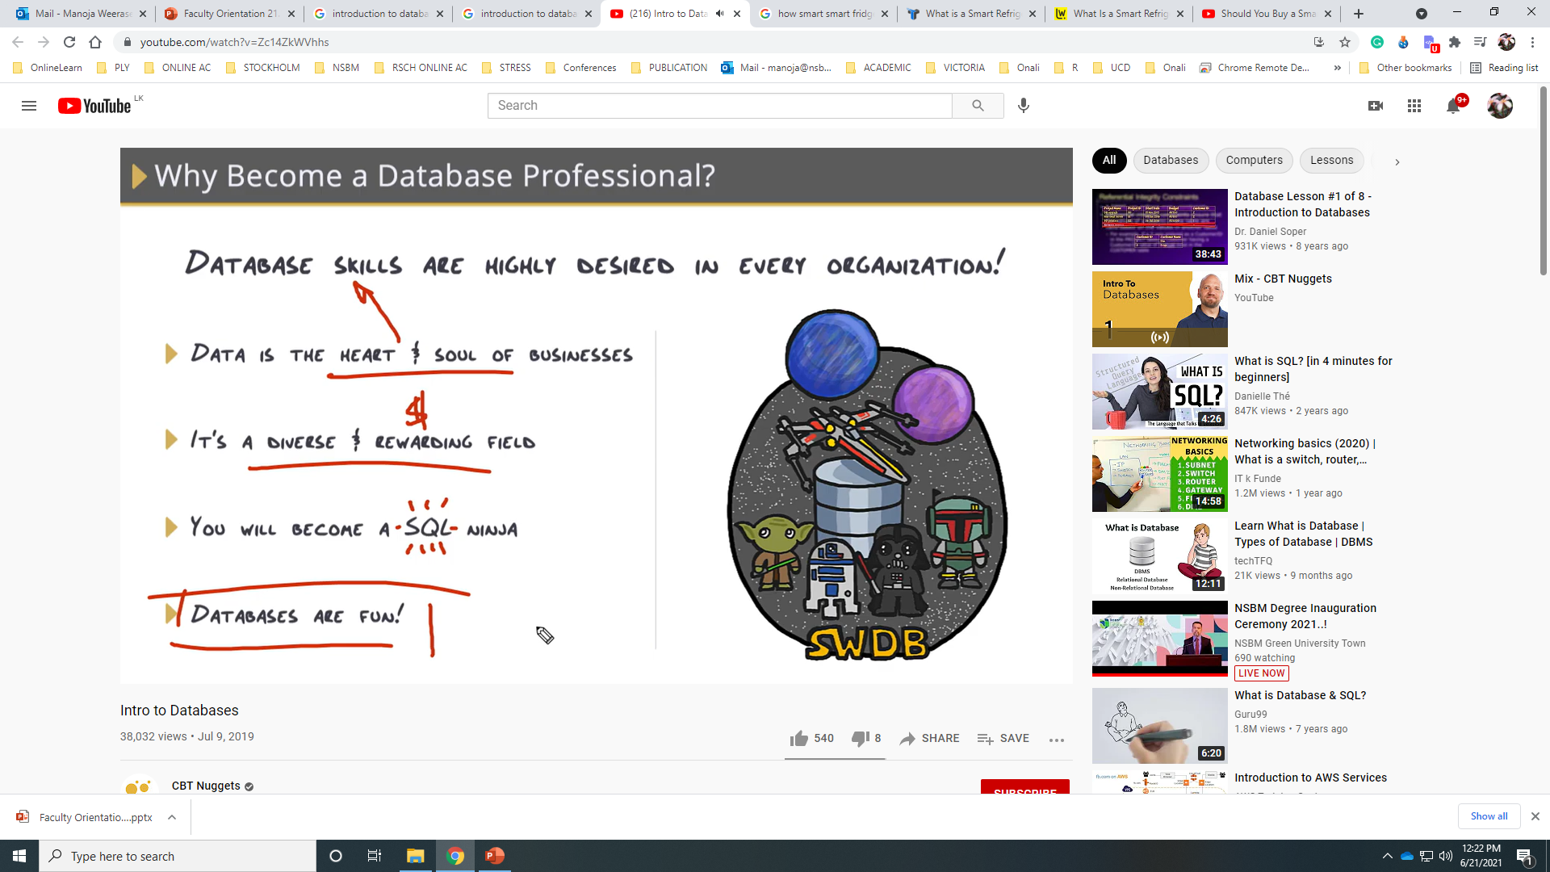

Slide 27
When Not to Use DBMS
Main inhibitors (costs) of using a DBMS:
High initial investment and possible need for additional hardware
Overhead for providing generality, security, concurrency control, recovery, and integrity functions
When a DBMS may be unnecessary:
If the database and applications are simple, well defined, and not expected to change
If access to data by multiple users is not required
When a DBMS may be infeasible
In embedded systems where a general-purpose DBMS may not fit in available storage

Slide 28
Recent Developments (1)
Social Networks started capturing a lot of information about people and about communications among people-posts, tweets, photos, videos in systems such as:
- Facebook
- Twitter
- Linked-In
All of the above constitutes data
Search Engines, Google, Bing, Yahoo: collect their own repository of web pages for searching purposes

Slide 29
Recent Developments (2)
New technologies are emerging from the so-called non-SQL, non-database software vendors to manage vast amounts of data generated on the web:
Big data storage systems involving large clusters of distributed computers (Chapter 25)
NOSQL (Non-SQL, Not Only SQL) systems (Chapter 24)
A large amount of data now resides on the “cloud” which means it is in huge data centers using thousands of machines.

Slide 30

Thank You

